Slide 1


Slide 2
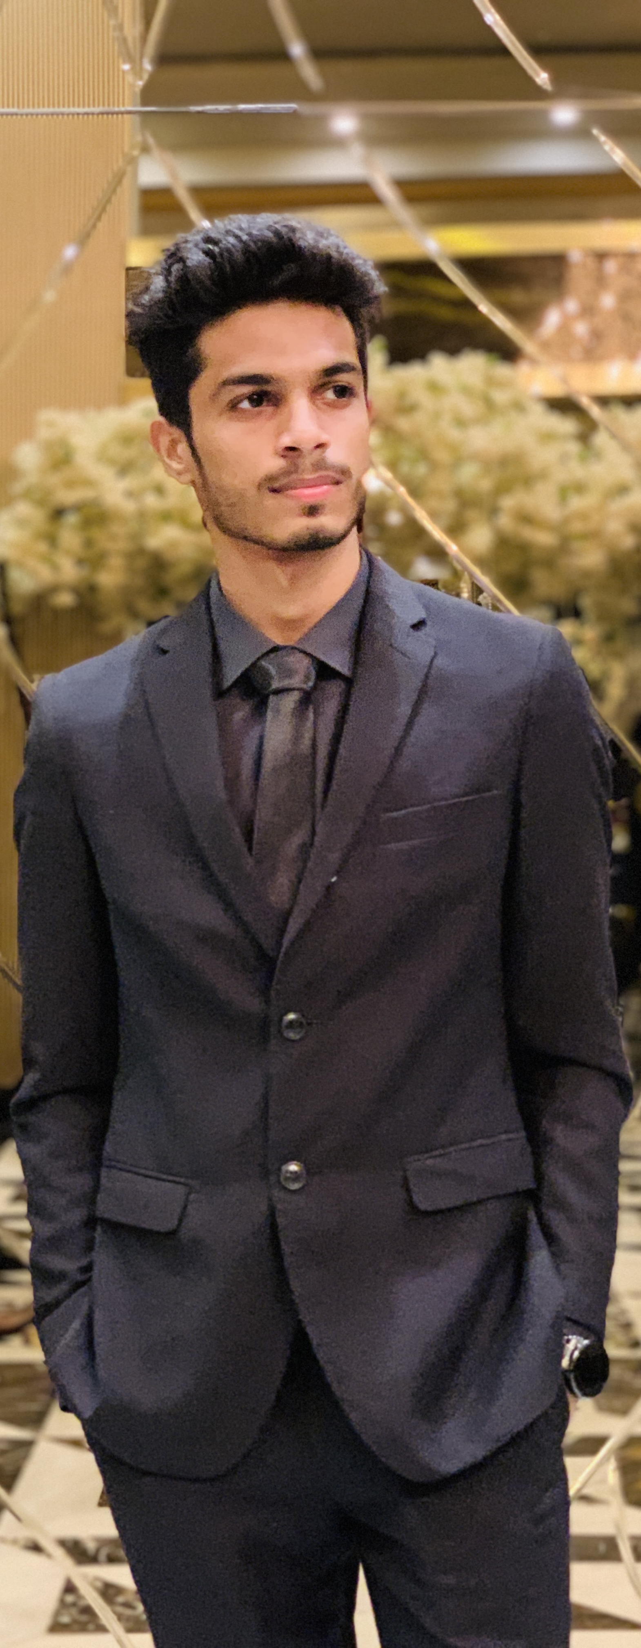
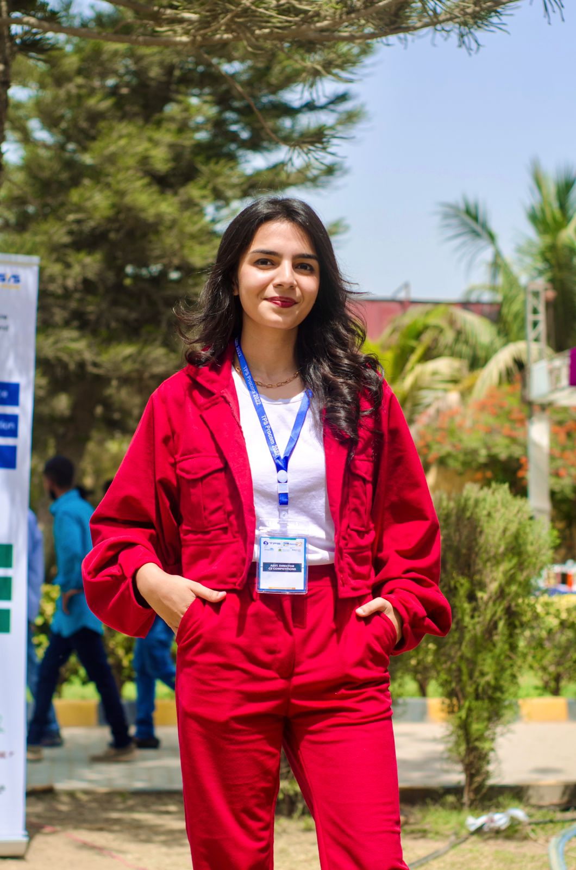
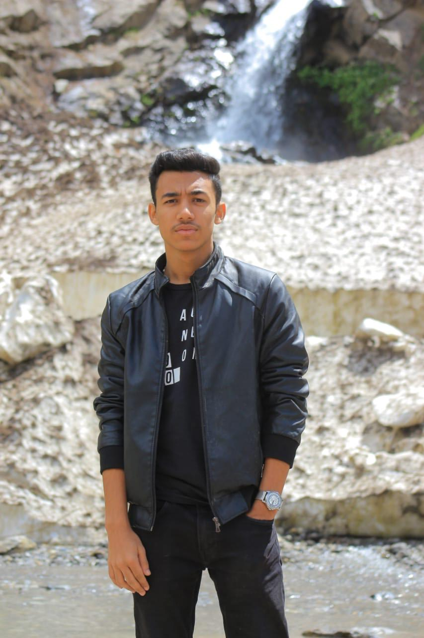
THE TEAM
Mashood Nadeem
Naba Jafri
Amman Soomro
Member 02
Member 01
Group Leader

Slide 3
Table of Content
01
04
Problem Statement
Architectural Diagram
02
05
Motivation
Features
03
06
Objective
Milestone

Slide 4
Problem Statement
The objective is to eradicate the hassle incurred by the existent method as students highly desire to be facilitated. Students want assistance while going through the projects their seniors worked on, they require some recommendations for the electives they would be offered in order to pick the best one. Furthermore, struggle in the attainment of course material, and struggle of the final year in finding an idea or a direction for their FYP are one of the few issues faced by students

Slide 5
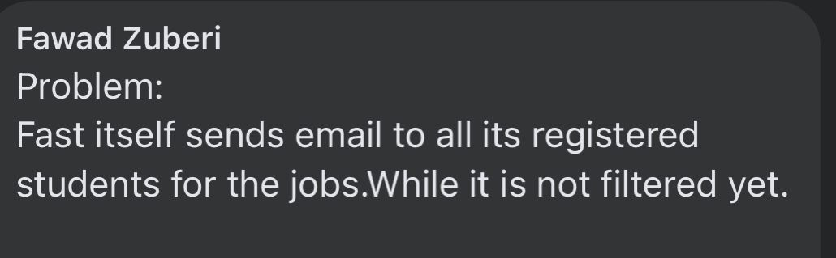
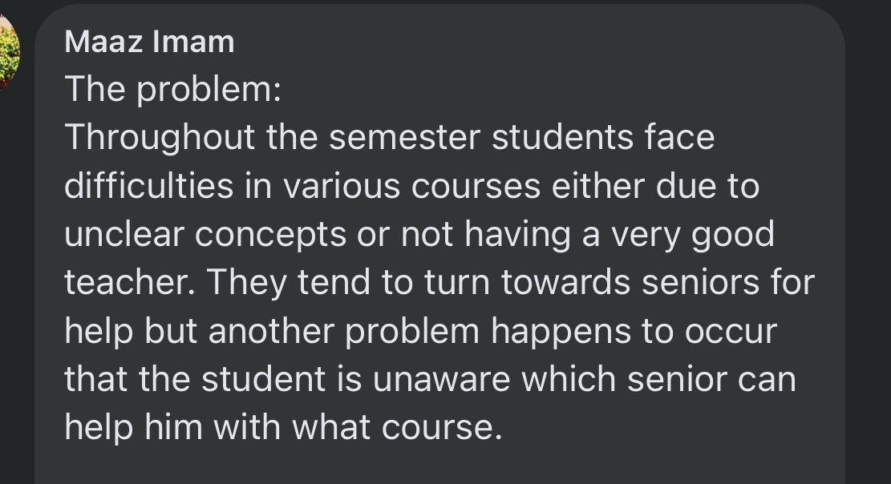
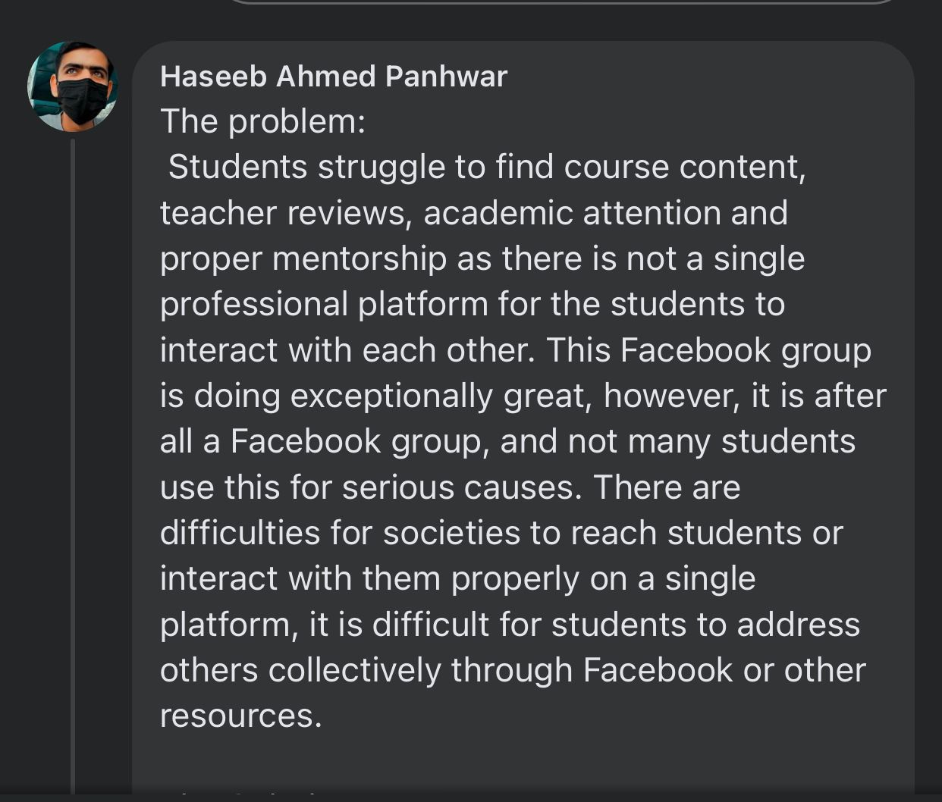
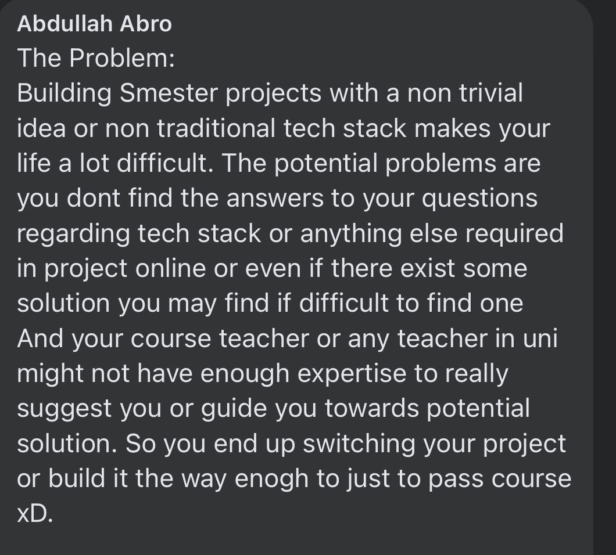
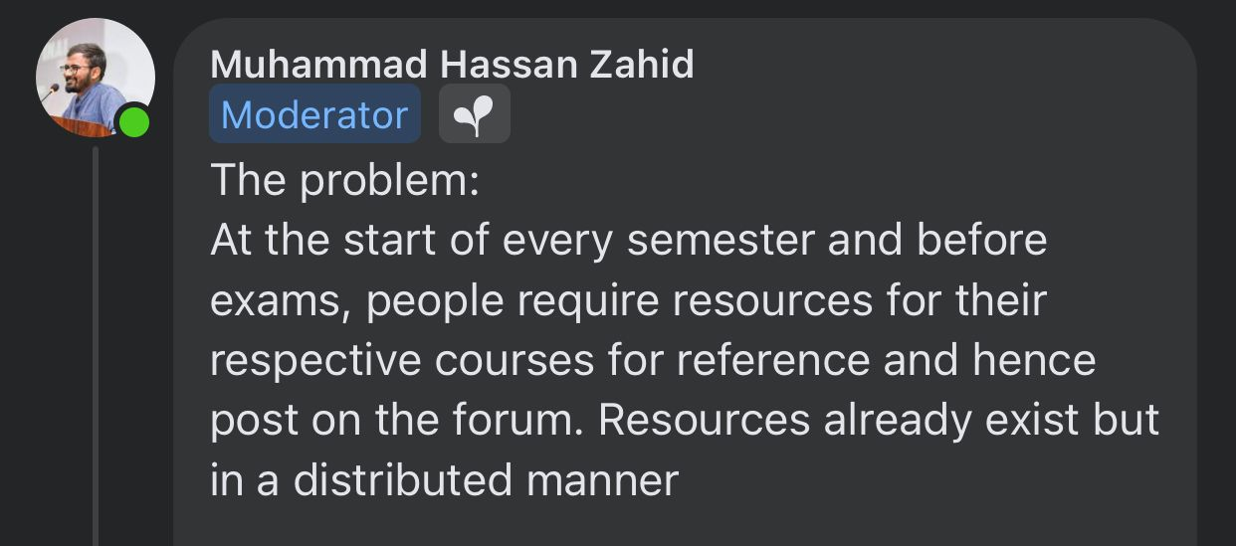
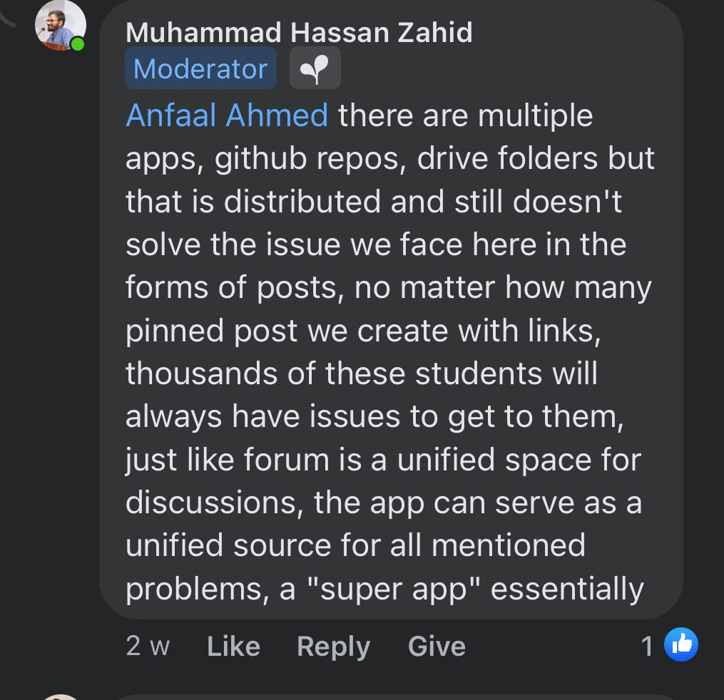
Motivation
Rather than having data distributed throughout different places/sites such as GCR, Slate, Flex, GitHub, Facebook, Google Drive, etc. Why not have a single virtual “One Stop” where all the students are facilitated under one roof?

Slide 6
Objectives
Provide Students with a user-friendly web application which let provides them always access to relevant course and teacher information.
Make sure that they do not miss out on important emails and notifications due to any reason.
Have Alumni help students regarding their queries and FYP ideas.

Slide 7





Architecture Diagram
Technologies:
Back-End
Database
Front-End

Slide 8








User
Front-End
Request
File Storage
API
Query Process
Admin Panel
Admin
Database
Response

Slide 9
Features
Feature 01
Feature 02
Feature 03

Slide 10
Project Milestones
4 Weeks
8-10 Weeks
Project
Initiation
Project Delivery
6-8 Weeks
4 Weeks
Data Gathering: SRS
Coding and Database Integration
Design and Analysis: SDS
Project Testing

Slide 11
THANKS!
Does anyone have any question?
addyouremail@freepik.com
+91 620 421 838
yourcompany.com

